Slide 1
EC2 p2.xlarge instance losing GPU support after reboot
NVIDIA-SMI has failed because it couldn't communicate with the NVIDIA drive
Deep Learning AMI (Ubuntu) Version 21.2 doesn't have tensorflow-gpu install

Slide 2
Potential links for related Issues
https://forums.aws.amazon.com/thread.jspa?messageID=894270&tstart=0
https://forums.aws.amazon.com/thread.jspa?messageID=894100&tstart=0
https://forums.aws.amazon.com/thread.jspa?messageID=904486
https://stackoverflow.com/questions/55261273/aws-ec2-instance-losing-gpu-support-after-reboot

Slide 3
Possible Reason
Change in Kernel
Possible mismatch between conda/ pip versions
Solution
Check if CUDA/ CUDNN/ TF-GPU are matching as per https://www.tensorflow.org/install/source#tested_build_configurations
CUDA - nvcc –version
CUDNN - cat /usr/local/cuda/include/cudnn.h | grep CUDNN_MAJOR -A 2 https://gist.github.com/Jongbhin/ad9aac8369751dbd84ca6a266a507bc7

Slide 4
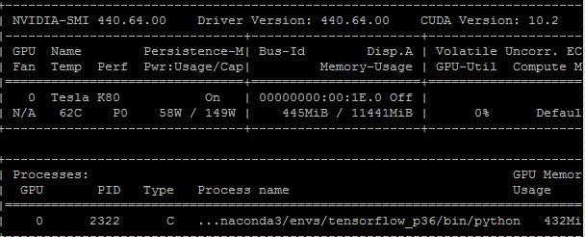
nvidia-smi to check GPU card information
https://yangcha.github.io/CUDA90/
https://askubuntu.com/questions/1097066/how-to-fix-unmet-dependencies-for-udevamd64-error-on-ubuntu-18-04

Slide 5
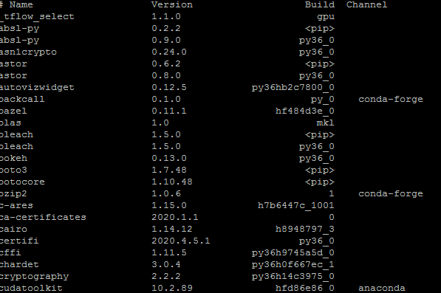
Uninstall all tensorflow versions
Uninstall all tensorflow dependencies that have pip
https://github.com/ContinuumIO/anaconda-issues/issues/9747
Install tensorflow-gpu
Restart the machine

